Slide 1
UNIT-IV
Genetic Algorithms for IOT, Optimisation, Deterministic and Analytic methods , Natural Optimisation Methods, Introduction to GA , Coding Genetic Algorithms , Reinforcement Learning for IOT, RL Terminology , Simulated Environments, Policy Gradients , Generative model for IoT ,

Slide 2
Optimization
Objective: To find the best solution.
In optimization, we try to adjust our variable parameters/processes/inputs so that we can find the minimum or maximum output.
Normally, the variables constitute the inputs, we have a function called an objective function, loss function or fitness function and as output we expect the cost/loss or fitness.
The cost or loss should be minimized, and if we define fitness, then it should be maximized. Here, we vary the inputs (variables) to achieve a desired (optimized) output.

Slide 3
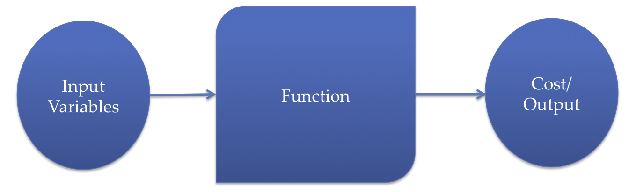
Relationship between input, the function to be optimized, and the output
The aim is to minimize the cost, such that the constraints specified by the function are satisfied by the input variables.
The mathematical relationship between the cost function, constraints, and input variables determines the complexity of the optimization problem.
One of the key issues is whether the cost function and constraints are convex or nonconvex.

Slide 4
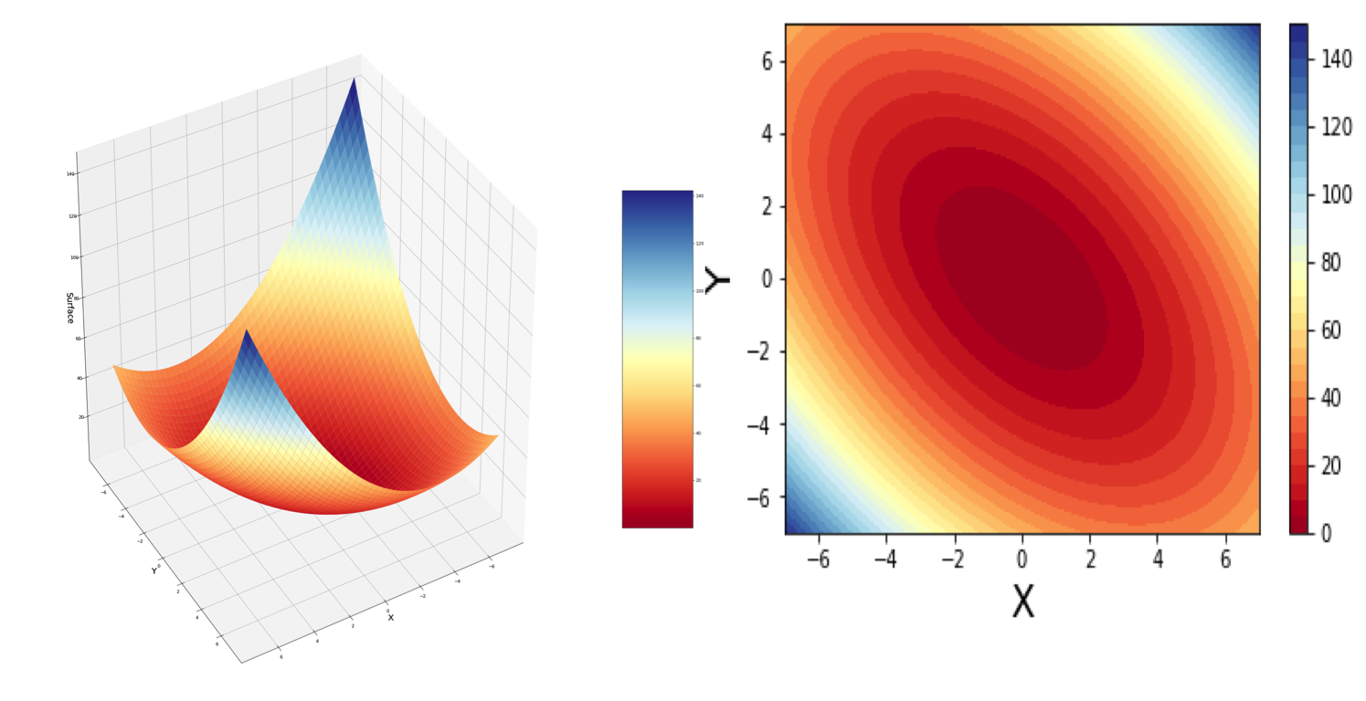
If the cost function and constraints are convex, we can be confident that there does exist a feasible solution, and if we search in a sufficiently large domain, we will find one.
The following figure shows an example of a convex cost function:
Figure: A convex cost function. The one on the left is the surface plot and the one on the right shows the contour plot of the same cost function. The darkest red point in the image corresponds to the optimum solution point.
If, on other hand, the cost function or constraints are non-convex, the optimization problem becomes harder and we cannot be sure that there does exist a solution, or that we can even find one.

Slide 5
Deterministic and analytic methods
When the objective function is smooth with a continuous second derivative, then we know
from the knowledge of calculus that at a local minimum the following are true:
In such conditions, for some problems, it is possible to find the solution analytically by determining the zeros of the gradient and verifying the positive definiteness of the Hessian matrix at the zeros.
So, in these cases, we can explore the search space iteratively for the minima of the objective function.

Slide 6
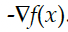
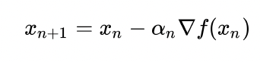
Gradient descent method
The search direction is the direction of the gradient descent
It is also called the Cauchy Method.
In 1847, Cauchy proposed this method.
We start from an arbitrary point on the objective function surface and change the variables along the direction of the gradient.
Mathematically, it is represented as follows:

Slide 7
Gradient descent algorithms have worked well in training DL models, but they have some severe drawbacks: 1. The performance of the optimizer used depends greatly on the learning rate and other constants. If you change them even slightly, there is a big possibility that the network may not converge.
2. Since these methods are based on derivatives, they do not work for discrete data.
3. We cannot reliably apply it when the objective function is non-convex, which is the case in many DL networks. The presence of many hidden layers can result in many local minima, and there is a strong possibility that the model gets stuck in a local minimum.

Slide 8
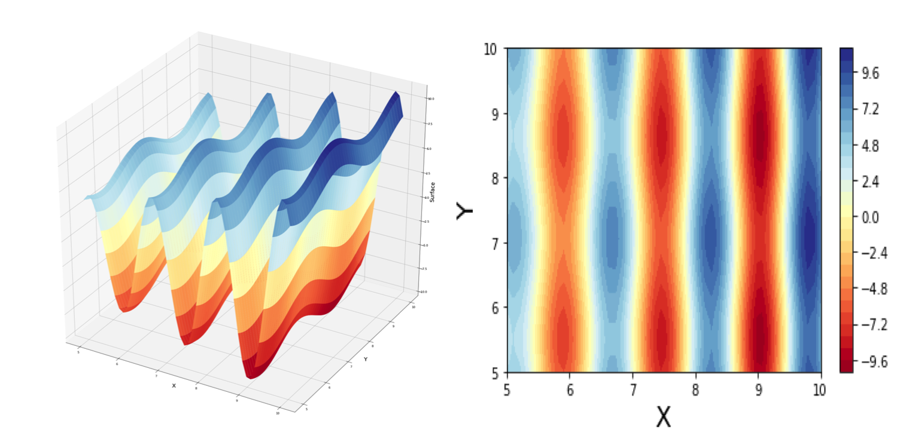
Figure: A cost function with many local minima. The one on the left is the surface plot and the one on the right shows the contour plot of the same cost function. The dark red points in the image correspond to minima.
There are many variants of the gradient descent method, and the most popular of them are available in the TensorFlow optimizers, including the following:
Stochastic gradient optimizer
Adam optimizer
Adagrad optimizer
RMSProp optimizer

Slide 9
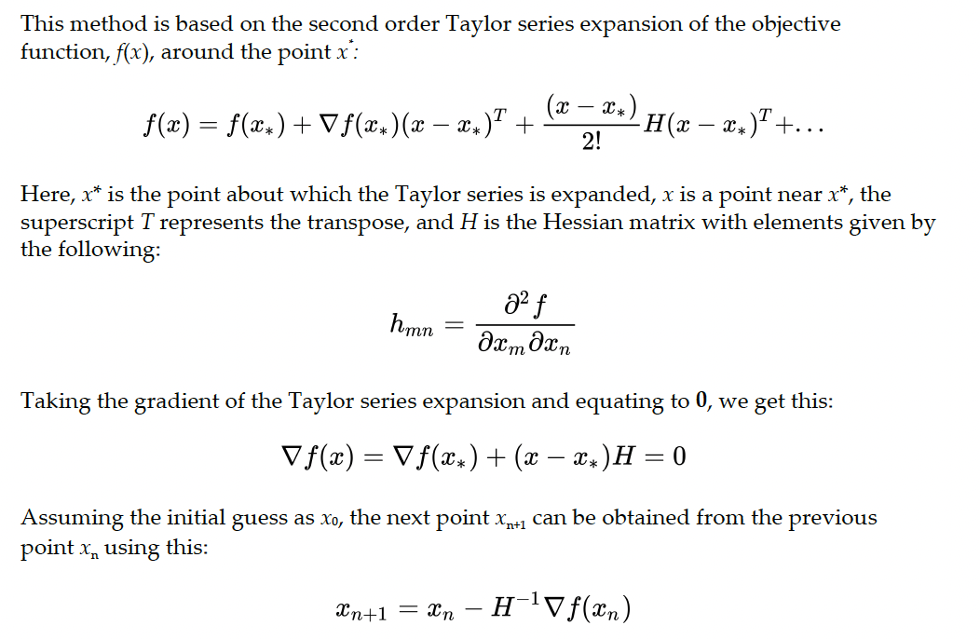
Newton-Raphson method

Slide 10
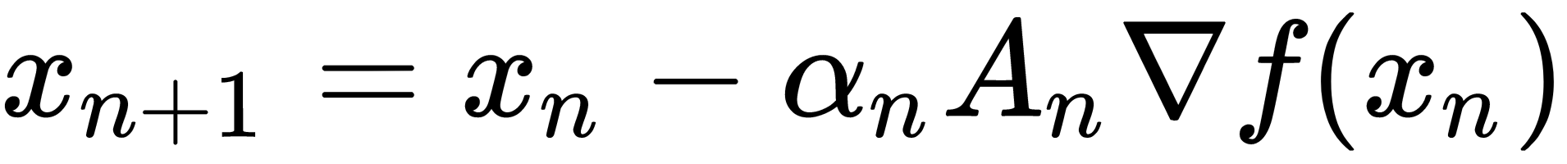
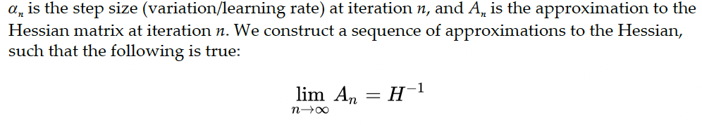
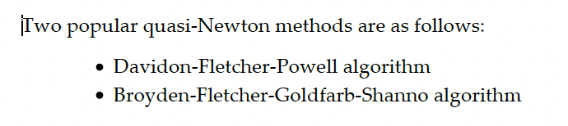
The method uses both the first and the second partial derivatives of the objective function to find the minima.
At iteration k, it approximates the objective function by a quadratic function around x(k) and moves toward its minima.
Since computing the Hessian matrix is computationally expensive and not normally known, a large number of algorithms exist around approximating the Hessian; these techniques are called quasi-Newton methods.
They can be represented as follows:

Slide 11
Natural optimization methods
Natural optimization methods are inspired by some natural processes, that is, a process, existing in nature, that is remarkably successful at optimizing some natural phenomena.
These algorithms do not require taking objective function derivatives, and thus can be employed even for discrete variables and non-continuous objective functions.
Simulated annealing
Simulated annealing is a stochastic method.
It is inspired by the physical process of annealing, in which a solid is first heated to a high enough temperature so that it melts, and then the temperature is decreased slowly; this allows the particles of the solid to arrange themselves in the lowest possible energy state and thus produce a highly structured lattice.

Slide 12
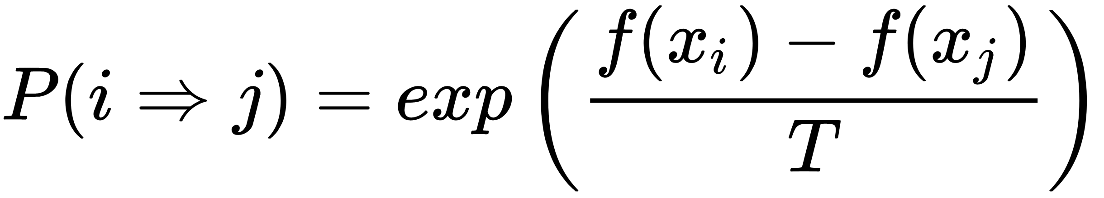
We start with some random values assigned to each variable; this represents the initial state.
At each step, we pick a variable (or group of variables) at random and then select a random value.
If, upon the assignment of that value to the variable, there is an improvement in the objective function, the algorithm accepts the assignment, there is a new current assignment, and the state of the system changes.
Otherwise, it accepts the assignment with some probability P, which depends on the temperature T and the difference between the values of the objective function in the current state and the new state.
If the change is not accepted, the current state remains unchanged.
Where T represents a variable analogous to temperature in the physical system. As the temperature approaches 0. The simulated annealing algorithm reduces to the gradient descent algorithm.

Slide 13
Particle Swarm Optimization
PSO was developed by Edward and Kennedy in 1995.
It is based on the social behavior of animals, such as a flock of birds.
You must have noticed in the sky, birds fly in a V shape.
Those who have studied bird behavior tell us that birds fly like this when in search of food or a better location, with the one leading being nearest to the desired source.
Now, when they fly, the leading bird does not remain the same; instead, it changes as they move.
The bird in the flock that sees the food sends a sound signal, and all other birds then collect around that bird in a V fashion.
This is a continuous repetitive process, and has served birds well for millions of years

Slide 14
PSO takes inspiration from this bird behavior and uses it to solve optimization problems. In PSO, every single solution is a bird called particle in the search space.
Each particle has a fitness value, which is evaluated by the fitness function to be optimized; they also have velocities, which direct the flying of the particles. The particles fly through the problem search space by following the current optimum particle.
The particles are moved around in the search space guided by two best fitness values, one their own best known position in the search space—pbest:particle best .
The entire swarm's best known fitness value– gbest : global best.
As improved positions are discovered, they are used to guide the movements of the particles of the swarm.
This process is repeated and it is hoped that an optimum solution will eventually be discovered.

Slide 15
Introduction to Genetic algorithm
According to the work of Charles Darwin, the famous biologist, the animal and plant species that we see today have emerged due to millions of years of evolution.
The process of evolution is guided by the principle of survival of the fittest selecting the organisms that have a better chance of survivability.
The organisms that are most capable of both acquiring the resources and procreation are the ones whose descendants will have more chances of survival.
Each being has a different number of chromosomes and they contain thousands of genes. For example, we homo sapiens have 46 chromosomes and these chromosomes contain about 20,000 genes.
Each gene represents a specific rule: a person will have blue eyes, will have brown hair, will be a female, and so on. These genes pass from parents to offspring through the process of reproduction.

Slide 16
Genetic algorithm
This method was developed by John Holland in 1975.
It was shown that it can be used to solve an optimization problem by his student Goldberg, who used genetic algorithms to control gas pipeline transmission.
To apply genetic algorithms to solving optimization problems using the computer, as the first step we will need to encode the problem variables into genes.
The genes can be a string of real numbers or a binary bit string (series of 0s and 1's). This represents a potential solution (individual) and many such solutions together form the population at time t.
For instance, consider a problem where we need to find two variables, a and b such that the two lie in the range (0, 255).
For binary gene representation, these two variables can be represented by a 16-bit chromosome, with the higher 8 bits representing gene a and the lower 8 bits for b.
The encoding will need to be later decoded to get the real values of the variables a and b.

Slide 17
The second important requirement for genetic algorithms is defining a proper, fitness function which calculates the fitness score of any potential solution.
This is the function that we want to optimize by finding the optimum set of parameters of the system or the problem at hand. The fitness function is problem-dependent.
For example, in the natural process of evolution, the fitness function represents the organism's ability to operate and to survive in its environment.
Steps involved:
Population Initialization
We need to create an initial population, where all chromosomes are (usually) randomly generated to yield an entire range of possible solutions
The population size depends on the nature of the problem, but typically contains several hundred potential solutions encoded into chromosomes.

Slide 18
2. Parent Selection
For each successive generation, based on the fitness function (or randomly), we next select a certain proportion of the existing population.
This selected proportion of the population will then breed to form a new generation
3. Reproduction:
We next generate the successive generation from those selected in step 2, through genetic operators such as crossover and mutation.
These genetic operators ultimately result in a child (next generation) population of chromosomes that is different from the initial generation but at the same time shares many of the characteristics of its parents.
4. Evaluation:
The offspring generated are then evaluated using the fitness function, and they replace the least-fit individuals in the population to keep the population size unchanged.
5. Termination:
If any of the offspring achieve the objective fitness score or the maximum number of generations is reached, then the genetic algorithm process is terminated

Slide 19
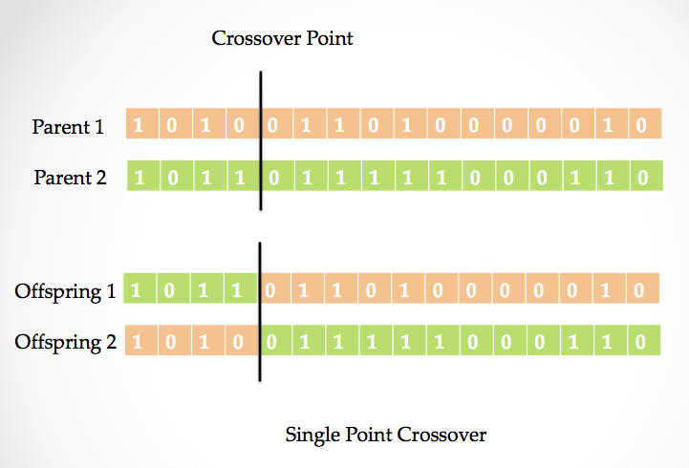
Crossover
To perform the crossover operation, we select a random position on the chromosome of two parents, then the genetic information is swapped between them about this point, with a Probability Px.
This results in two new offspring. When the crossover takes place over a random point, it is called a one-point crossover.

Slide 20
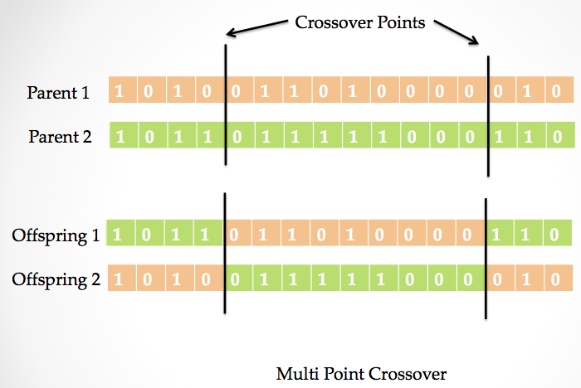
We can also have more than one point where parents' genes are swapped; this is called a Multi-Point Crossover.
There exist a lot of crossovers people have tried, for example, uniform crossover, order based
crossover, and cyclic crossover.

Slide 21
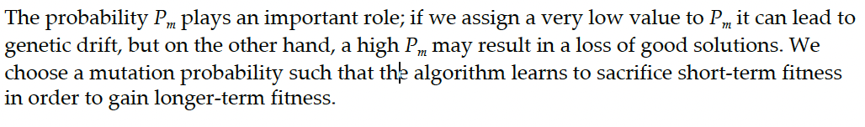
Mutation
While the crossover operation ensures variety and can help speed up the search, it does not generate new solutions.
This is the work of the mutation operator, which helps in maintaining and introducing diversity in the population.
The mutation operator is applied to certain genes (bits) of the child chromosomes with a probability Pm.
We can have a bit flip mutation; if we consider our earlier example, then in the 16-bit chromosome, the bit flip mutation will cause a single bit to change its state
There is a possibility that we set the gene to a random value for all possible values. This is called random setting.

Slide 22
Advantages
They can be used to optimize either continuous or discrete variables.
Unlike gradient descent, we do not require derivative information, which also means that there is no need for the fitness function to be continuous and differentiable.
It can simultaneously search from a wide sampling of the cost surface.
We can deal with a large number of variables without a significant increase in computation time.
The generation of the population and calculating their fitness values can be performed in parallel, and hence genetic algorithms are well suited for parallel computers.
They can work even when the topological surface is extremely complex because crossover and mutation operators help them in jumping out of a local minimum.
They can provide more than one optimum solution.
We can use them with numerically generated data, experimental data, or even analytical functions. They specifically work well for large-scale optimization problems.

Slide 23
Disadvantages
If the optimization function is a well-behaved convex function, then gradient based methods will give a faster convergence
The large population of solutions that helps genetic algorithms cover the search space more extensively also results in slow convergence
Designing a fitness function can be a daunting task

Slide 24
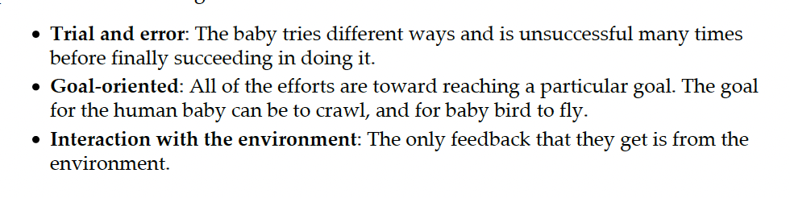
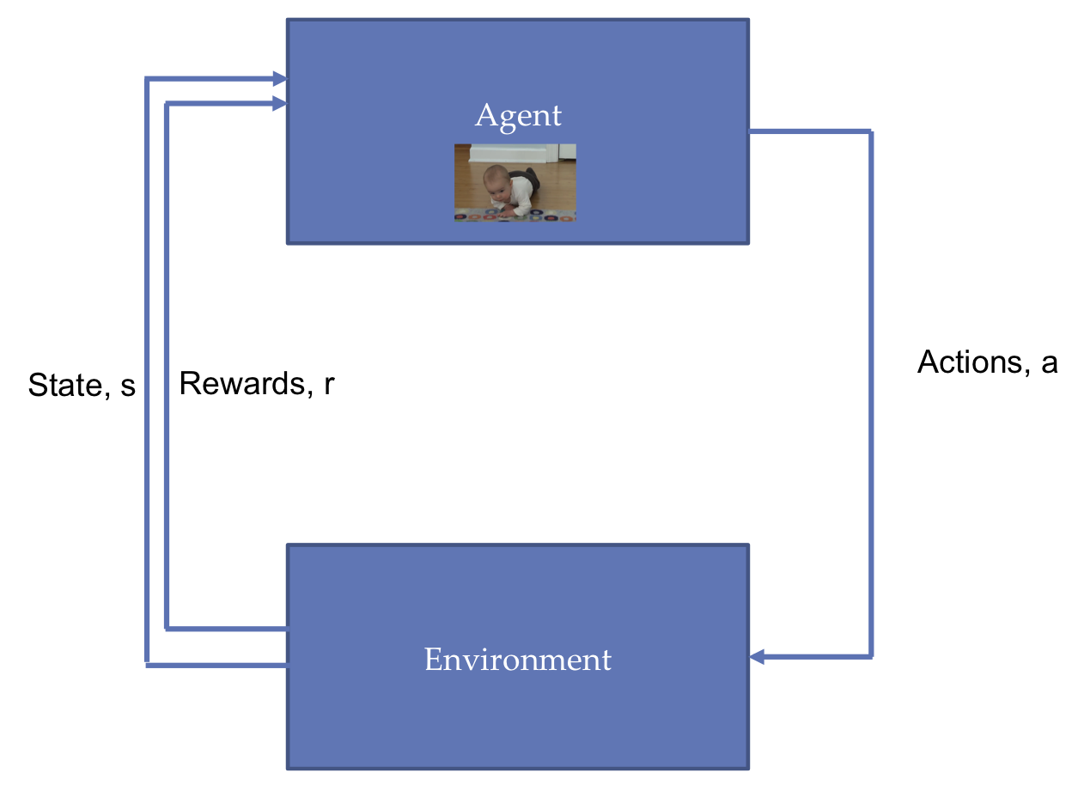
Reinforcement Learning for IoT

Slide 25
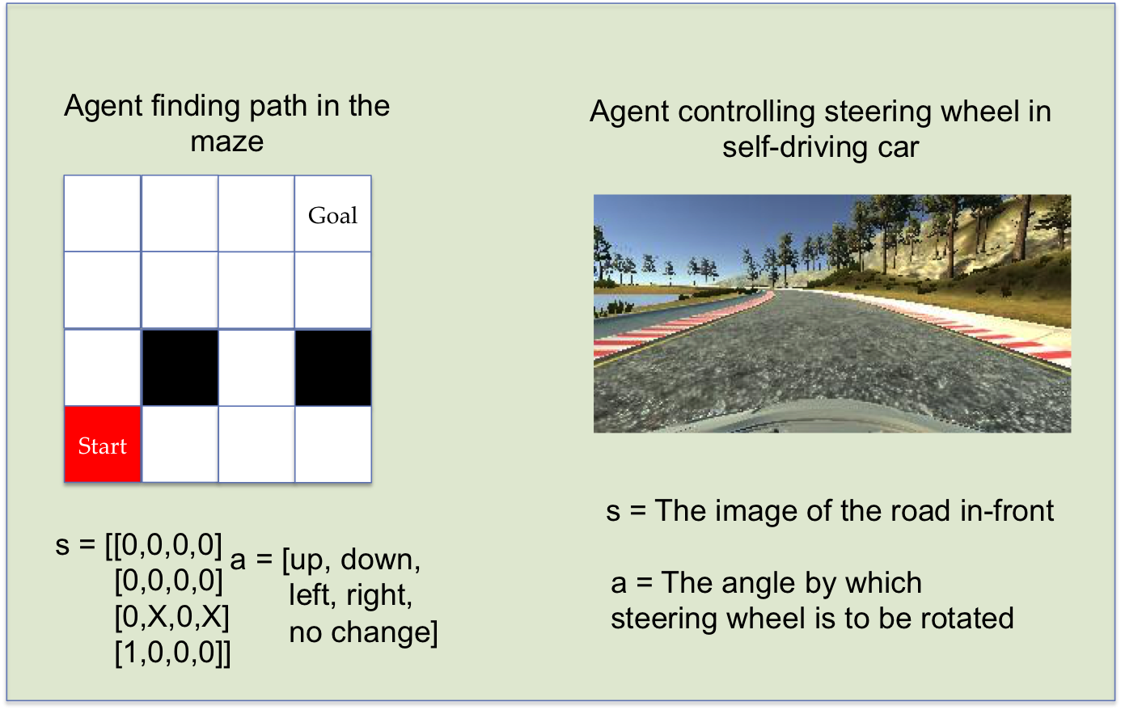
RL terminology

Slide 26
States s:
The states can be thought of as a set of tokens (or representation) that can define all of the possible states the environment can be in.
The state can be continuous or discrete. For example, in the case of an agent finding a path through a maze, the state can be represented by a 4x4 array, with a 0 representing an empty block 1 representing a block occupied by the agent, and X the state that can't be occupied; the states here are discrete in nature.
In the case of an agent steering the wheel, the state is the view in front of the SDC. The image contains continuous valued pixels
Actions a(s):
Actions are the set of all possible things that the agent can do in a particular state. The set of possible actions a depends on the present state s.
They can be discrete or continuous.
The agent in the maze can perform five discrete actions [up, down, left, right and no change]

Slide 27
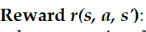
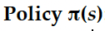
It's a scalar value returned by the environment when the agent selects an action. It defines the goal; the agent gets a higher reward if the action brings it near the goal, and a low (or even negative) reward otherwise.
How we define a reward is totally up to us—in the case of the maze, we can define the reward as the Euclidean distance between the agent's current position and goal.
The SDC agent reward can be that the car is on the road (positive reward) or off the road (negative reward).
It defines a mapping between each state and the action to take in that state. The policy can be deterministic—that is, for each state a well-defined policy.
Like for the maze agent, a policy can be that if the top block is empty, move up. The policy can also be stochastic—that is, where an action is taken by some probability.
It can be implemented as a simple look-up table, or it can be a function dependent on the present state. The policy is the core of the RL agent.

Slide 28
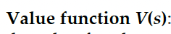
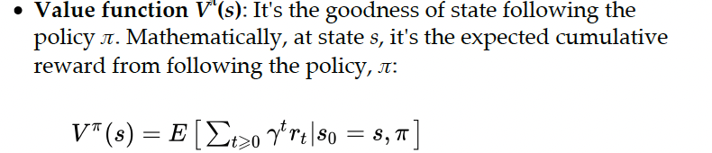
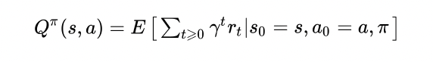
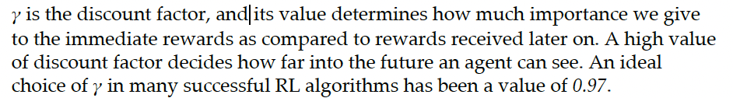
It defines the goodness of a state in the long run. It can be thought of as the total amount of reward the agent can expect to accumulate over the future, starting from the state s.
It's the goodness of a state s taking action a and thereafter following policy

Slide 29
Model of the environment
It mimics the behavior of the environment, and it contains the physics of the environment; in other words, it defines how the environment will behave. The model of the environment is defined by the transition probability to the next state.

Slide 30
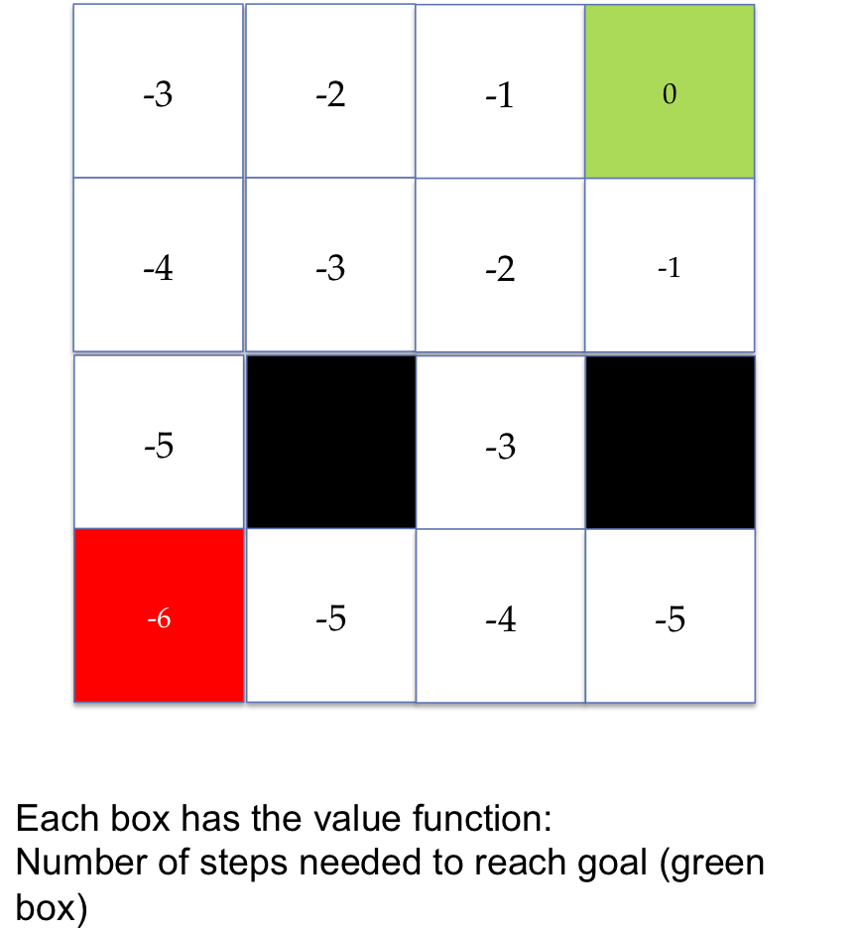
Deep reinforcement learning
RL algorithms can be classified into two, based on what they iterate/approximate:
Value-based methods
In these methods, the algorithms take the action that maximizes the value function. The agent here learns to predict how good a given state or action would be.
Hence, here, the aim is to find the optimal value. An example of the value-based method is Q-learning.
Consider, for example, our RL agent in a maze: assuming that the value of each state is the negative of the number of steps needed to reach from that box to the goal, then, at each time step, the agent will choose the action that takes it to a state with optimal value, as in the following diagram.
So, starting from a value of -6, it'll move to -5,-4,-3,-2,-1 and eventually reach the goal with the value 0.

Slide 31
Policy-based methods
In these methods, the algorithms predict the best policy which maximizes the value function.
The aim is to find the optimal policy. An example of the policy-based method is policy gradients.
Here, we approximate the policy function, which allows us to map each state to the best corresponding action.

Slide 32
OpenAI gym:
It contains a collection of environments that we can use to train our RL agents.
Unity ML-Agents SDK
It allows developers to transform games and simulations created using the Unity editor into environments where intelligent agents can be trained using DRL, evolutionary strategies, or other machine learning methods through a simple-to-use Python API.
It works with TensorFlow and provides the ability to train intelligent agents for two-dimensional/threedimensional and VR/AR games.
Gazebo
Gazebo, we can build three-dimensional worlds with physics-based simulation. Gazebo along with Robot Operating System and the OpenAI gym interface is gym-gazebo and can be used to train RL agents.
Blender learning environment
It's a Python interface for the Blender game engine, and it also works over OpenAI gym. It has it's base Blender.
A free three dimensional modeling software with an integrated game engine, this provides an easy-to-use, powerful set of tools for creating games.
https://gymnasium.farama.org/environments/atari/
Simulated Environments

Slide 33
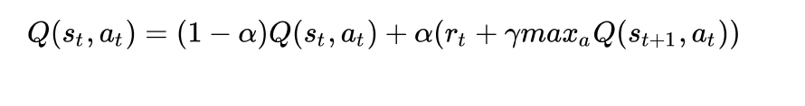
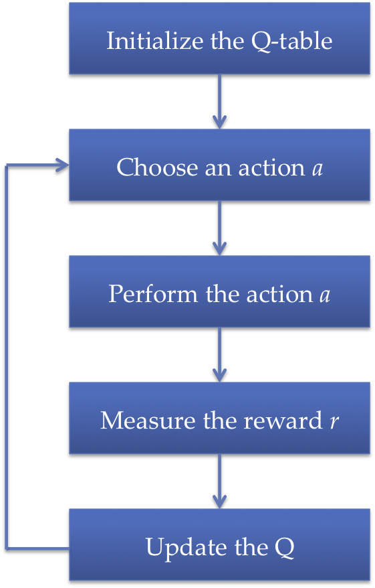
Q-learning
The goal of Q-learning is to learn an optimal action selection policy. The update in Q-value
is performed dynamically with the help of the Bellman Equation,

Slide 34
One-Step Q-Learning Algo
0. S ← initial state
1. If random # ≤ P
then a = random choice
Else a = Π_{t}(S)
2. S_{new} ← W(S, a)
R_{immed} ← R(S_{new})
Q(S, a) ← R_{immed} + γ max_{a’} Q(S_{new}, a’)
4. S ← S_{new}
Go to 1
Act on world and get reward

Slide 35
A Simple Example (of Q-learning - with updates after each step, ie N =1)
S₁
R = 1
Let γ = 2/3
Q = 0
S₀
R = 0
Q = 0
Q = 0
Q = 0
S₃
R = 0
S₂
R = -1
Algo: Pick State +Action
Q = 0
Q = 0
S₄
R = 3
Repeat
(deterministic world, so α=1)

Slide 36
A Simple Example (Step 1) S₀ → S₂
S₁
R = 1
Let γ = 2/3
Q = 0
S₀
R = 0
Q = 0
Q = -1
Q = 0
S₃
R = 0
S₂
R = -1
Algo: Pick State +Action
Q = 0
Q = 0
S₄
R = 3
Repeat
(deterministic world, so α=1)

Slide 37
A Simple Example (Step 2) S₂ → S₄
S₁
R = 1
Let γ = 2/3
Q = 0
S₀
R = 0
Q = 0
Q = -1
Q = 0
S₃
R = 0
S₂
R = -1
Algo: Pick State +Action
Q = 0
Q = 3
S₄
R = 3
Repeat
(deterministic world, so α=1)

Slide 38
A Simple Example (Step )
S₁
R = 1
Let γ = 2/3
Q = 1
S₀
R = 0
Q = 0
Q = 1
Q = 0
S₃
R = 0
S₂
R = -1
Algo: Pick State +Action
Q = 0
Q = 3
S₄
R = 3
Repeat
(deterministic world, so α=1)

Slide 39
Q-Learning: Implementation Details
Remember, conceptually we are filling in a huge table
States
S0 S1 S2 . . . Sn
Actions
a
b
c
.
.
.
z
.
.
.
Tables are a very verbose representation of a function
. . . Q(S2, c)

Slide 40
Deep Q-Networks (DQN)
Introduced deep reinforcement learning
It is common to use a function approximator Q(s, a; θ) to approximate the action-value function in Q-learning
Deep Q-Networks is Q-learning with a deep neural network function approximator called the Q-network
Discrete and finite set of actions A
Example: Breakout has 3 actions – move left, move right, no movement
Uses epsilon-greedy policy to select actions

Slide 41
Q-Networks
Core idea: We want the neural network to learn a non-linear hierarchy of features or feature representation that gives accurate Q-value estimates
The neural network has a separate output unit for each possible action, which gives the Q-value estimate for that action given the input state
The neural network is trained using mini-batch stochastic gradient updates and experience replay

Slide 42
Experience Replay
The state is a sequence of actions and observations s_{t} = x₁, a₁, x₂, …, a_{t-1}, x_{t}
Store the agent’s experiences at each time step e_{t} = (s_{t}, a_{t}, r_{t}, s_{t+1}) in a dataset D = e₁, ..., e_{n} pooled over many episodes into a replay memory
In practice, only store the last N experience tuples in the replay memory and sample uniformly from D when performing updates

Slide 43
State representation
It is difficult to give the neural network a sequence of arbitrary length as input
Use fixed length representation of sequence/history produced by a function ϕ(s_{t})
Example: The last 4 image frames in the sequence of Breakout gameplay

Slide 44
Q-Network Training
Sample random mini-batch of experience tuples uniformly at random from D
Similar to Q-learning update rule but:
Use mini-batch stochastic gradient updates
The gradient of the loss function for a given iteration with respect to the parameter θ_{i} is the difference between the target value and the actual value is multiplied by the gradient of the Q function approximator Q(s, a; θ) with respect to that specific parameter
Use the gradient of the loss function to update the Q function approximator

Slide 45
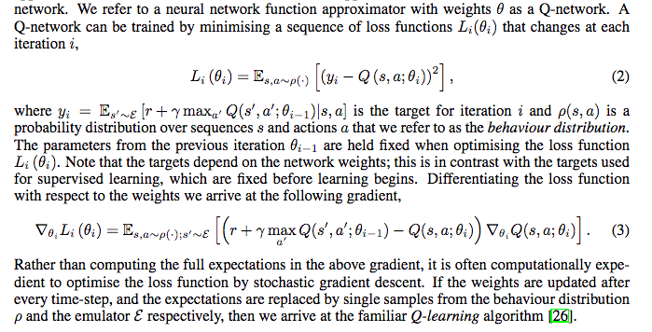
Loss Function Gradient Derivation

Slide 46
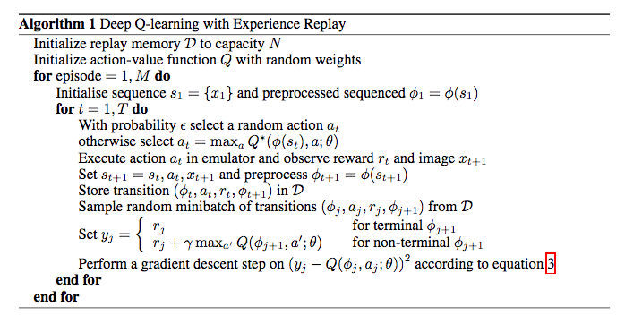
DQN Algorithm

Slide 47
What are Policy Gradient Methods?
Before: Learn the values of actions and then select actions based on their estimated action-values. The policy was generated directly from the value function
We want to learn a parameterised policy that can select actions without consulting a value function. The parameters of the policy are called policy weights
A value function may be used to learn the policy weights but this is not required for action selection
Policy gradient methods are methods for learning the policy weights using the gradient of some performance measure with respect to the policy weights
Policy gradient methods seek to maximise performance and so the policy weights are updated using gradient ascent

Slide 48
Policy-based Reinforcement Learning
Search directly for the optimal policy π*
Can use any parametric supervised machine learning model to learn policies π(a |s; θ) where θ represents the learned parameters
Recall that the optimal policy is the policy that achieves maximum future return

Slide 49
Notation
Policy weight vector θ
The policy is π(a | s, θ), which represents the probability that action a is taken in state s with policy weight vector θ
If using learned value functions, the value function’s weight vector is w
Performance measure η(θ)
Episodic case: η(θ) = v_{π}(s₀)
Performance is defined as the value of the start state under the parameterised policy

Slide 50
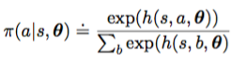
Policy Approximation
The policy can be parameterised in any way provided π(a | s, θ) is differentiable with respect to its weights
To ensure exploration, we generally require that the policy never becomes deterministic and so π(a | s, θ) is in interval (0, 1)
Assume discrete and finite set of actions
Form parameterised numerical preferences h(s, a, θ) for each state-action pair
Can use a deep neural network as the policy approximator
Use softmax so that the most preferred actions in each state are given the highest probability of being selected

Slide 51
Types of Policy Gradient Method
Finite Difference Policy Gradient
Monte Carlo Policy Gradient
Actor-Critic Policy Gradient

Slide 52
Finite Difference Policy Gradient
Compute the partial derivative of the performance measure η(θ) with respect to θ_{k} using finite difference gradient approximation
Compute performance measure η(θ)
Perturb θ by small positive amount epsilon in the kth dimension and compute performance measure η(θ + u_{k}ε) where u_{k} is unit vector that is 1 in kth component and 0 elsewhere
The partial derivative is approximated by
( η(θ + u_{k}ε) - η(θ) ) / ε
θ_{k} <- θ_{k} + α ( η(θ + u_{k}ε) - η(θ) ) / ε
Perform gradient ascent using the partial derivative
Simple, noisy and inefficient procedure that is sometimes effective
This procedure works for arbitrary policies (can be non-differentiable)

Slide 53
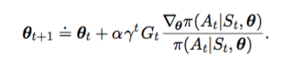
REINFORCE: Monte Carlo Policy Gradient
We want a quantity that we can sample on each time step whose expectation is equal to the gradient
We can then perform stochastic gradient ascent with this quantity

Slide 54
REINFORCE Properties
On-policy method
Uses the complete return from time t, which includes all future rewards until the end of the episode
REINFORCE is thus a Monte Carlo algorithm and is only well-defined for the episodic case with all updates made in retrospect after the episode is completed
Note that the gradient of log x is the gradient of x divided by x by the chain rule

Slide 55
Actor-Critic Methods
Methods that learn approximations to both policy and value functions are called actor-critic methods
Actor refers to the learned policy
Critic refers to the learned value function, which is usually a state-value function
The critic is bootstrapped – the state-values are updated using the estimated state-values of subsequent states
The number of steps in the actor-critic method controls the degree of bootstrapping

Slide 56
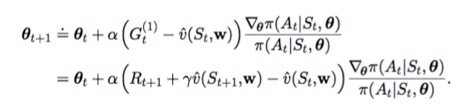
One-step Actor-Critic Update Rules
On-policy method
The state-value function update rule is the TD(0) update rule
The policy function update rule is shown below.
For n-step Actor-Critic, simply replace G_{t}⁽¹⁾ with G_{t}^{(n)}

Slide 57
Generative Models for IoT
The main idea is to generate new samples having the same distribution as the given training data; for example, a network trained handwritten digits can create new digits that aren't in the dataset but are similar to them.
If the training data follows the distribution Pdata(X), then the goal of generative models is to estimate the probability density function Pmodel (X), which is similar to Pdata (x).
Generative models can be classified into two types:
﻿Explicit generative models: Here, the probability density function P, model (x) is explicitly defined and solved. The density function may be tractable as in the case of PixelRNN/CNN, or an approximation of the density function as in the case of VAE.
﻿Implicit generative models: In these, the network learns to generate a sample from P model (X) without explicitly defining it. GANs are an example of this type of generative model.

Slide 58
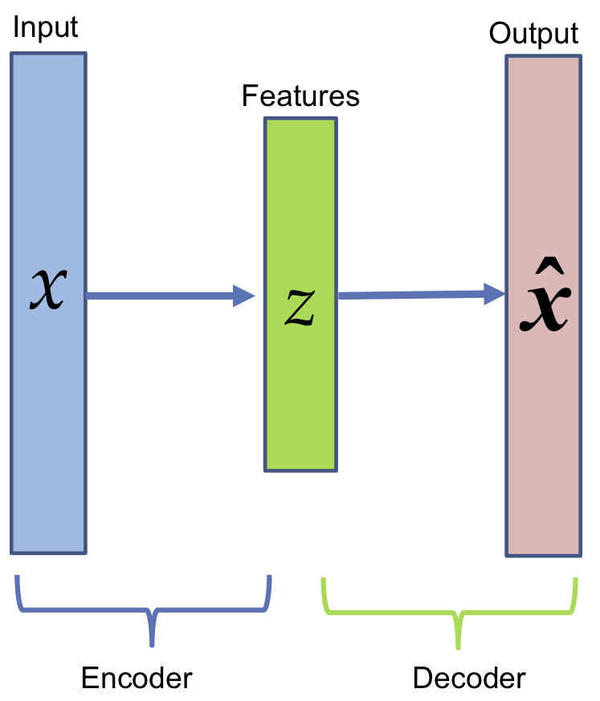
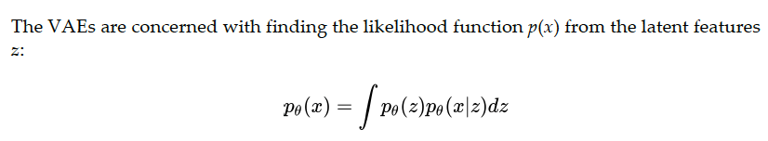
Generating images using VAEs
VAEs are a type of autoencoder; here, we retain the (trained) Decoder part, which can be used by feeding random latent features z to generate data similar to the training data.
The architecture of autoencoders

Slide 59
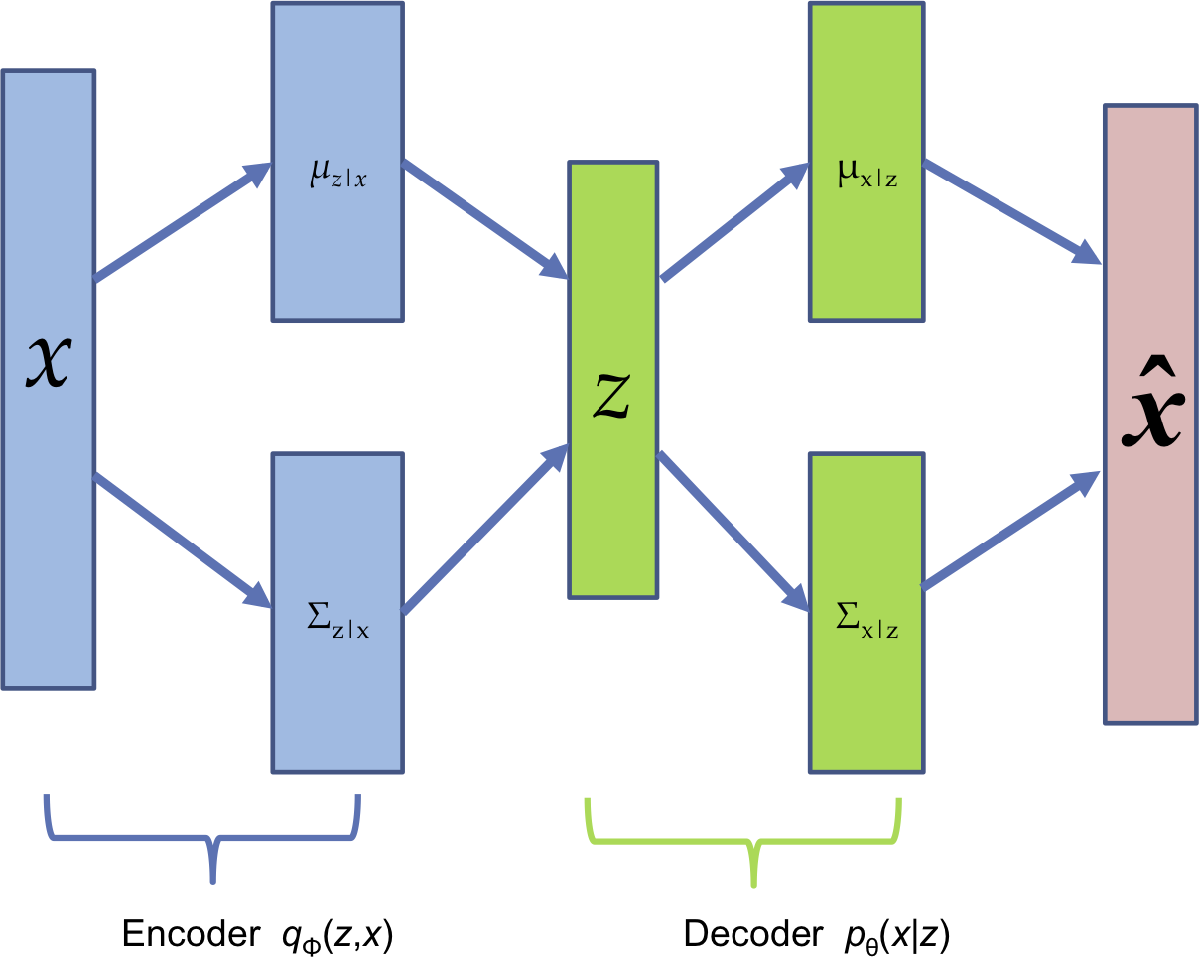
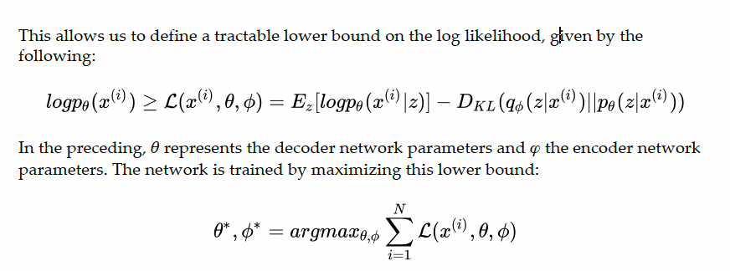
This is an intractable density function, and it isn't possible to directly optimize it; instead, we obtain a lower bound by using a simple Gaussian prior p(z) and making both Encoder and Decoder networks probabilistic.
The first term in the lower bound is responsible for the reconstruction of the input data, and the second term for making the approximate posterior distribution close to prior.
Once trained, the encoder network works as a recognition or inference network, and the decoder network acts as the generator.

Slide 60
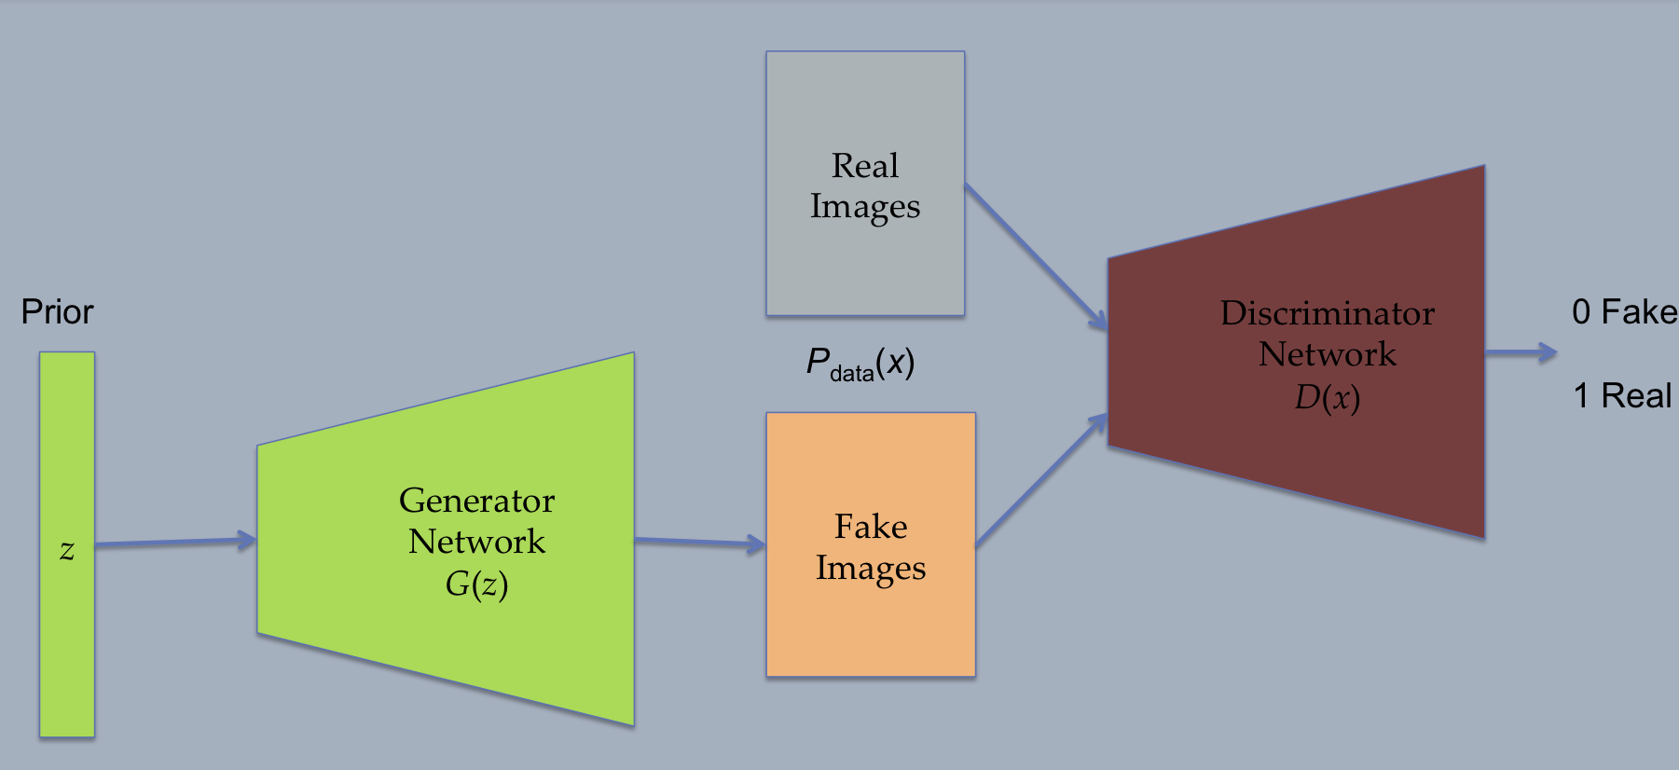
GANs
The generative network tries to generate data similar to the input data, and the discriminator network has to identify whether the data it's seeing is real or fake (that is, generated by a generator).
Every time the discriminator finds a difference between the distribution of true input and fake data, the generator adjusts its weights to reduce the difference.
To summarize, the discriminative network tries to learn the boundary between counterfeit and real data, and the generative network tries to learn the distribution of training data.
As the training ends, the generator learns to produce images exactly like the input data distribution, and the discriminator can no longer differentiate the two

Slide 61
Here the Discriminator, D(x), learns. The Generator, G(z), is used to generate Fake Images from random noise z (which follows some Prior distribution P(z)).
The Fake Images from the Generator and the Real Images from the training dataset are both fed to the Discriminator and it performs supervised learning trying to separate fake from real. If Pdata (x) is the training dataset distribution, then the Discriminator Network tries to maximize its obiective so that D(x) is close to 1 when the input data is real, and close to 0 when the input data is fake.
This can be achieved by performing the gradient ascent on the following objective function:

Slide 62
In the next step, the Generator Network learns. Its goal is to fool the Discriminator Network into thinking that generated G(z) is real, that is, force D(G(z)) close to 1. To achieve this, the Generator Network minimizes the objective:
The two steps are repeated sequentially. Once the training ends, the discriminator is no longer able to discriminate between real and fake data and the generator becomes a pro at creating data very similar to the training data.

